Slide 1
SECURE FILE TRANSFER MONITORING SYSTEM
Blue Team Defensive Security Project
BY: U M MOHAMED YUSUF SHERIFF
DATE: JAN 29/01/2026

Slide 2
INTRODUCTION
File transfers pose risks such as data leakage and insider misuse
Organizations require monitoring and audit mechanisms
This project demonstrates real-time file activity monitoring
Designed for educational and defensive purposes

Slide 3
OBJECTIVES
Monitor file creation, modification, deletion, and movement
Detect unauthorized access to sensitive directories
Verify file integrity using SHA-256 hashing
Generate alerts for policy violations
Maintain structured audit logs

Slide 4
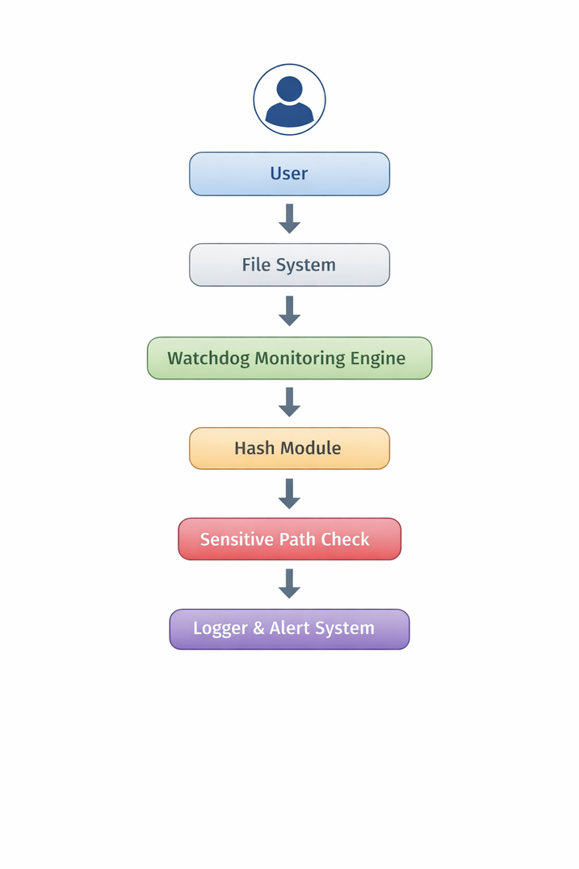
SYSTEM
ARCHITECTURE

Slide 5

IMPLEMENTATION & RESULTS
Implementation:
Developed using Python
Used watchdog for event detection
Used hashlib for integrity verification
Testing Results:
File creation logged successfully
File modification logged with updated hash
Sensitive file movement triggered alert
All activities recorded in log file

Slide 6
CONCLUSION & FUTURE ENHANCEMENTS
Conclusion:
Demonstrates real-time file monitoring
Successfully detects sensitive file movement
Enhances data visibility and defensive posture
Future Enhancements:
Email/SMS alerts
SIEM integration
YARA rule detection
Behavioral analysis
Cloud monitoring support

